Slide 1
Youtube
Documentary Videos
Mandar Kakade
Manoj Preveen
-FIRST PRESENTATION

Slide 2
ALGORITHM: COMPLETE PATH :
Subtitle file
Words
Tokens
Annotated Text
Doc
Tokenize
Stop words
Removed
POS Tagging
Keyword
Extraction
Keywords
Synsets in correct sense
Keywords in correct sense
WSD
Keywords
WordNet
Word Sense Disambiguation
.
Category.
(Using Extended Wordnet Domains)
Category
Domains
Domain with Highest Occurrence Score

Slide 3
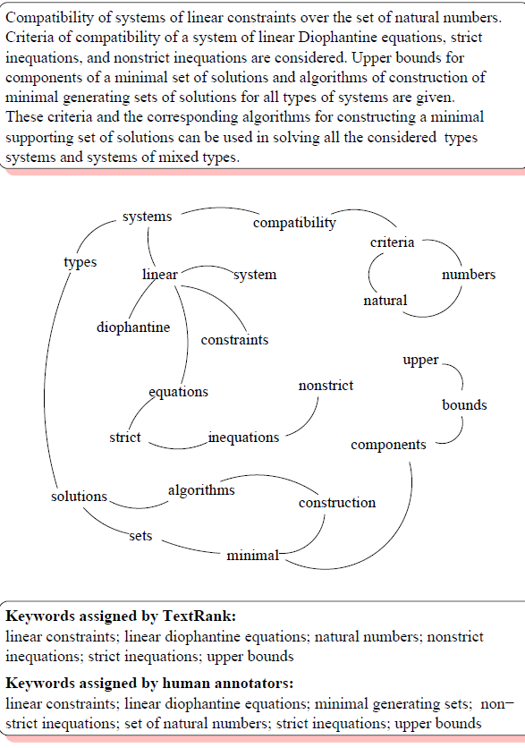
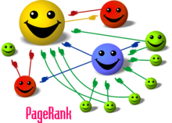
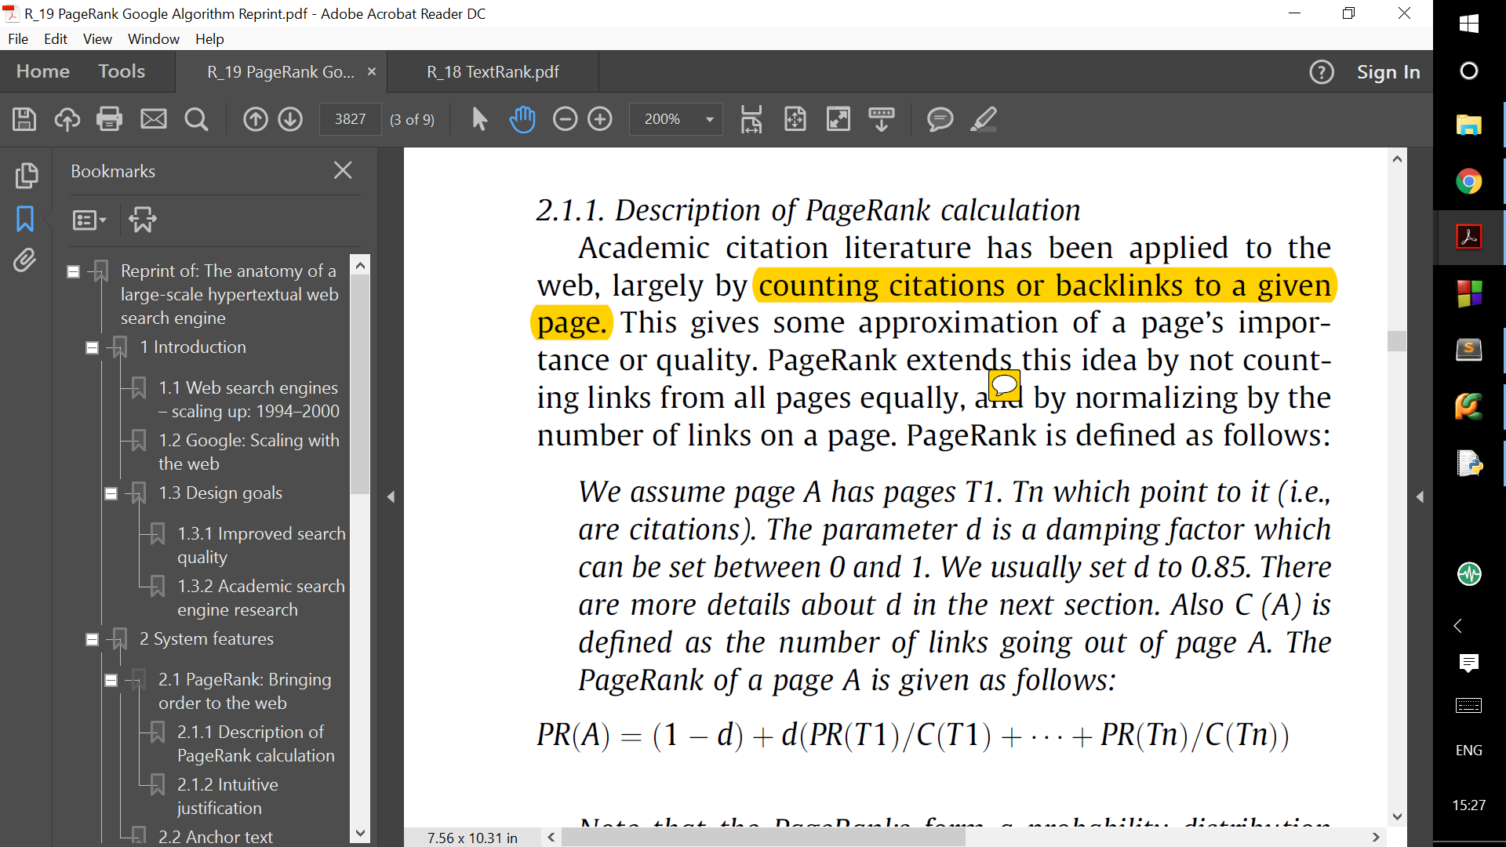
PageRank Algorithm
TextRank Algorithm
If docs T1….Tn point to A.

Slide 4
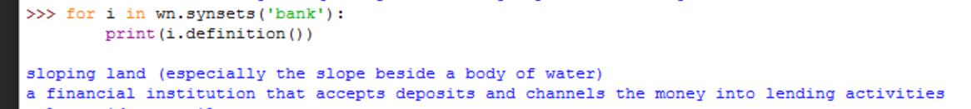
Lesk’s Algorithm
Financial Bank?
The bank of river Ganga is beautiful.
BANK
River Bank?
I borrowed money from a bank.
Domain of a word changes with sense.

Slide 5
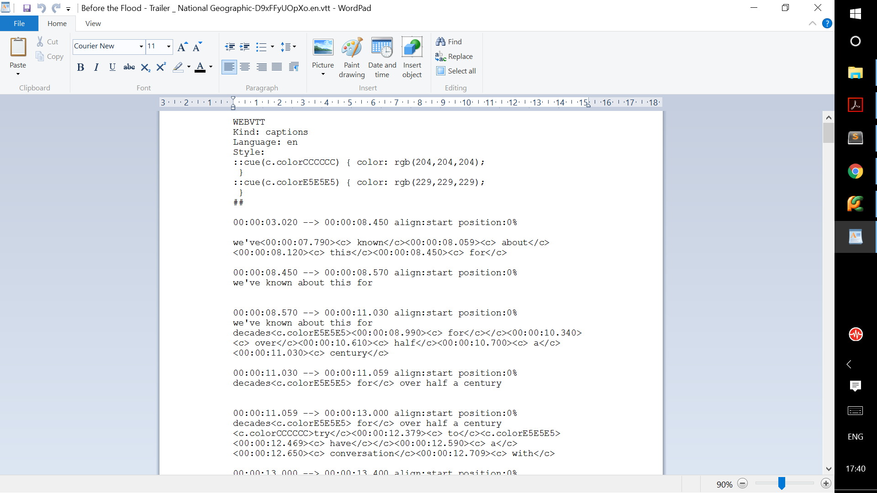
EXAMPLE: BEFORE THE FLOOD
INPUT: Subtitle files in ‘.vtt’ format

Slide 6
EXAMPLE: BEFORE THE FLOOD
2. Corresponding text file:
we've known about this for decades for over half a century try to have a conversation with anyone about climate change people just to now climate change climate change and the problem seems to be getting worse and worse worth the truth is the more I've learned about this issue and everything that contributes to the problem the more I realize how much I don't know oh my God look out violent that is paradise that has been degraded and destroyed or knowingly doing I just want to know how far we've gone and if there's anything we can do to stop it the US has been the biggest emitter of greenhouse gases in history your fossil addicted country we are doing more investment in solar today than the US half the people in office still don't believe in climate change why do you think there is such opposition about the science i think it's politics people are so arrogant to think they can change climate environmental issues have become the biggest reason for mass demonstrations we want to hold them accountable this is the most important issue of our time question is can we change our course in time you need a hundred get back to transition into energy that would make the United States for what the whole world all energy a sense that people all that I've seen on my journey shows us we have the means of stopping this devastation politicians do what the people want them to do what the American people are convinced the politicians will fall in line very quickly if we keep pushing there's no reason why we can't solve this problem the world is now watching we ask you to protect me are we and all living things we cherish our history yeah

Slide 7
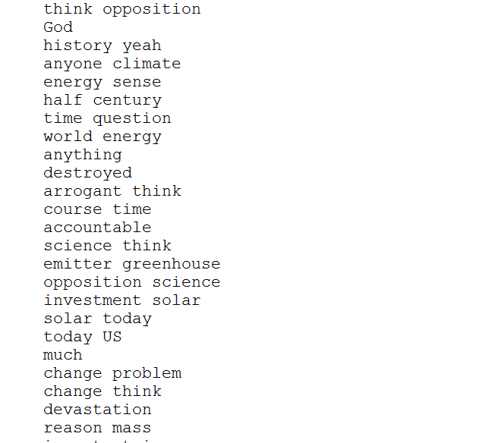
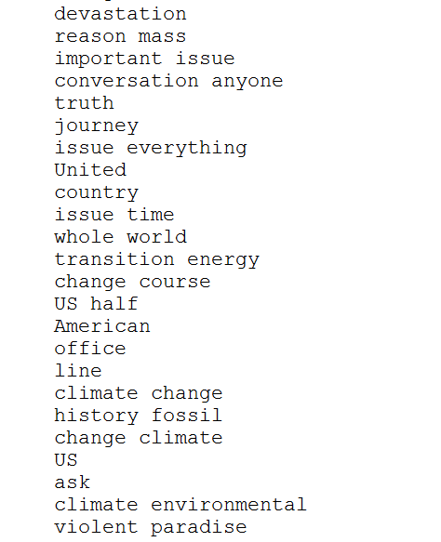
EXAMPLE: BEFORE THE FLOOD
3. Keywords:
4. Category:
ENVIRONMENT.

Slide 8
Results:
Correctness of the algorithm is about 40%.
TO INCREASE ACCURACY:
The inputs for the algorithm were auto-generated subtitles and hence contain a lot of errors.
Mapping between 164 Wordnet Domains and some GENERAL CATEGORIES.
Also videos were very short (2 min).
Thus improving the input can greatly increase correctness.

Slide 9
Thank You!
-FIRST PRESENTATION

